Slide 1
Design and Development of an AI-Powered Multi-Vendor E-Commerce Platform
DSA0105-Object Oriented Programming With C++
Supervised by
Mr.Jagadeesh K
Presented by
Hariprasad R(192421179)
Pranav Manikandan (1924260328)
Jayanth C (1925260087)
Arivazhagan M (1965260132)

Slide 2
ABSTRACT
The project titled “Design and Development of an AI-Powered Multi-Vendor E-Commerce Platform” aims to develop an online shopping system using C++. The platform allows customers and sellers to register, manage products, and process orders. Customers can browse products, add items to their shopping cart, and purchase products from different sellers. The AI recommendation system analyzes customer preferences, product categories, ratings, and purchase history to suggest suitable products. The system also helps identify popular products and improve the shopping experience. The main goal is to provide a simple, efficient, and personalized e-commerce platform for customers and sellers.

Slide 3
PROBLEM STATEMENT
Managing products from multiple sellers on a single platform is challenging.
Customers may find it difficult to identify suitable products from a large collection.
Manual product and order management can lead to errors.
Traditional shopping systems provide limited personalized product recommendations.
An AI-powered system is needed to improve product discovery, order management, and customer shopping experience.

Slide 4
OBJECTIVE
To develop secure customer and seller registration and login.
To manage products, prices, stock, and customer orders.
To implement AI-based product recommendation techniques.
To provide personalized shopping suggestions based on customer interests.
To improve product discovery and simplify online shopping.

Slide 5
PROPOSED SYSTEM
The proposed system uses C++ to manage customers, sellers, products, and orders. Customers can browse available products, add items to their cart, and place orders. Sellers can add, update, and manage their products. The AI recommendation component analyzes product categories, ratings, and purchase history to suggest relevant products. Compared with a basic shopping system, the proposed solution offers personalized recommendations and centralized management of multiple sellers.

Slide 6
TECHNOLOGIES USED
C++ – Backend development and product recommendation logic.
HTML – Creates the website structure.
CSS – Designs and styles the website.
JavaScript – Handles search, shopping cart, and interactive features.
GCC (MinGW) – Compiles and runs the C++ program.
cpp-httplib – Connects the website frontend with the C++ backend through HTTP APIs.
Visual Studio Code – Used to write and manage the project code. Google Chrome – Used to run and test the website

Slide 7
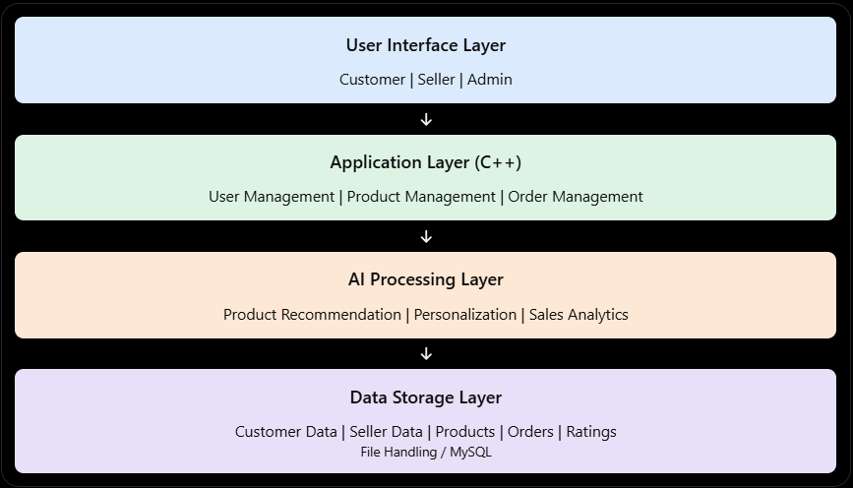
SYSTEM ARCHITECTURE

Slide 8
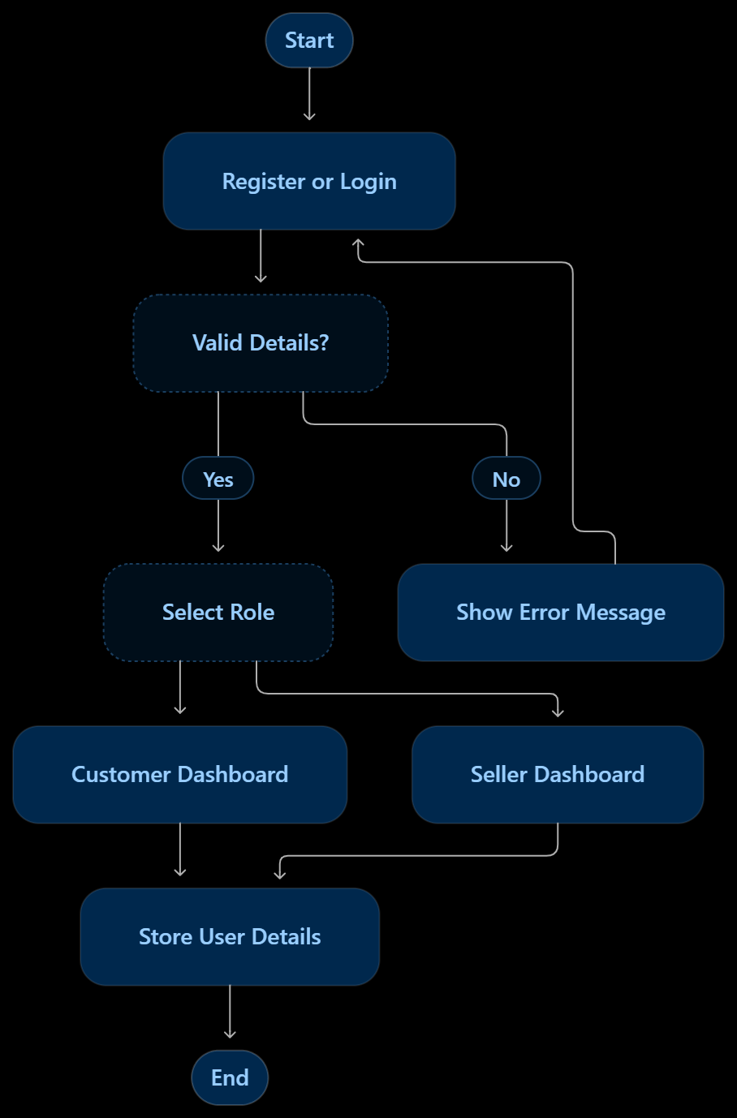
Module 1: User and Seller Management
Register new customers and sellers.
Implement secure login and logout functionality.
Validate usernames and passwords.
Manage customer and seller profile details.
Store and retrieve user information.

Slide 9
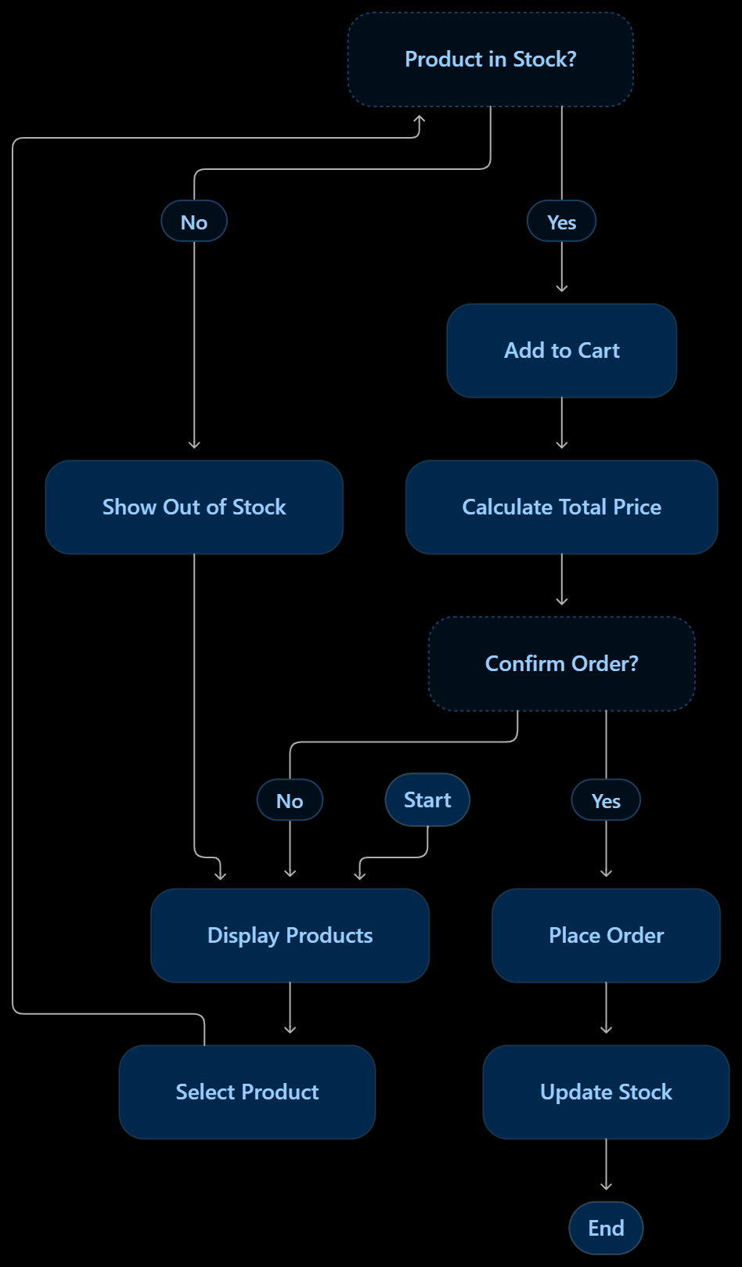
Module 2: Product and Order Management
Add, update, delete, and display products.
Manage product categories, prices, and stock quantities.
Allow customers to add or remove products from the cart.
Calculate the total price and process customer orders.
Update stock quantities and maintain order history.

Slide 10
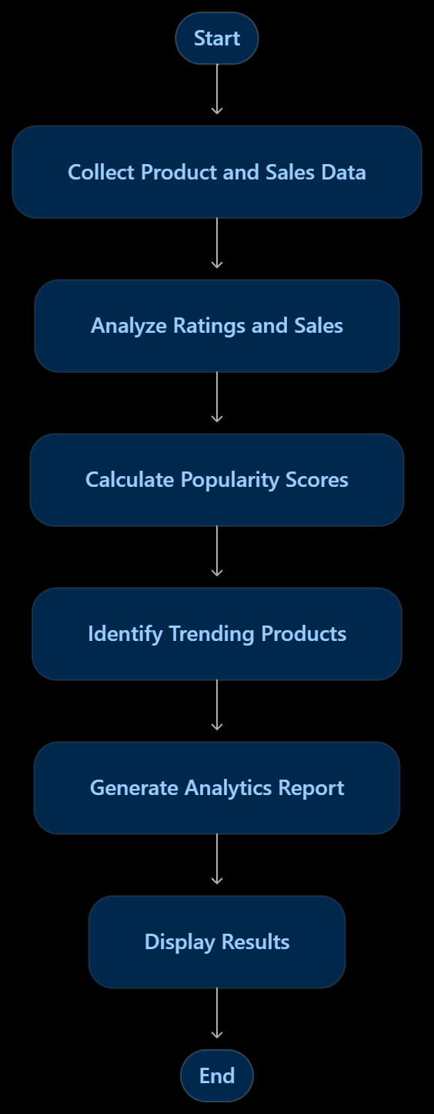
Module 3: AI Recommendation and Analytics Module
Analyze product ratings and sales data.
Identify popular products and categories.
Calculate product popularity scores.
Generate product and sales reports.
Display trending products based on available data.

Slide 11
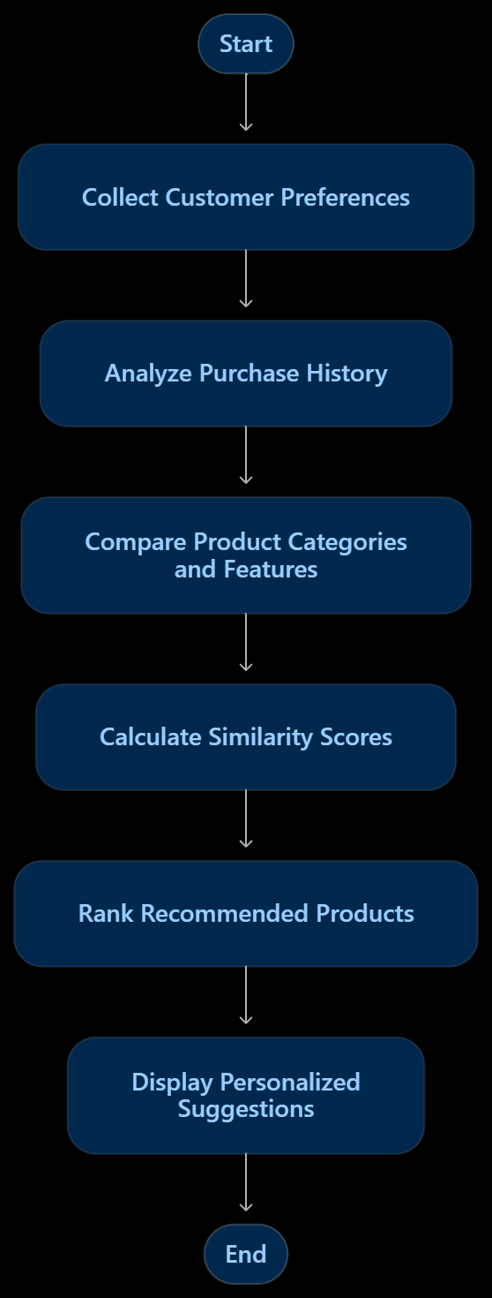
Module 4: AI-Powered Product Recommendation and Personalized Shopping
Collect customer preferences and purchase history.
Analyze product categories and features.
Calculate similarity scores between products.
Rank and recommend suitable products using content-based filtering.
Display personalized product suggestions to customers.

Slide 12
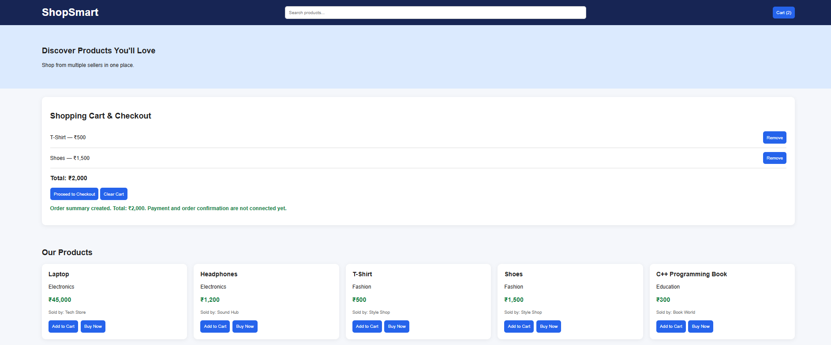
OUTPUT

Slide 13
ADVANTAGES
Easy Shopping: Customers can browse and purchase products online.
Multiple Sellers: Different sellers can sell their products on one platform.
AI Recommendations: Suggests products based on customer preferences.
Time Saving: Customers can search and compare products quickly.
Sales Analysis: Helps sellers identify popular products and improve sales.

Slide 14
CONCLUSION
The project focuses on developing an AI-powered multi-vendor e-commerce platform using C++.
It provides a centralized platform where multiple sellers can manage products, prices, and stock details.
Customers can browse products, add items to their cart, and place orders conveniently.
The AI-based recommendation system suggests relevant products based on customer preferences and product features.
Overall, the proposed system aims to simplify online shopping, improve product discovery, and support efficient product and order management.

Slide 15

Thank You!

